Slide 1
Barrow Hill Station Project
Staveley Town Deal Board
27 October 2023

Slide 2
Barrow Hill Line (BHL) Update
Project Sponsor: Department for Transport
Project Delivery: Network Rail
Key stakeholders: Derbyshire County Council | Chesterfield Borough Council
BHL Scope:
Chesterfield to Sheffield with stations in Derbyshire at Barrow Hill and Killamarsh
Clay Cross station, Whittington Station and Eckington/ Renishaw stations de-scoped from Outline Business Case development in August 2023 due to lower value for money contribution to BHL.
Network Rail commenced Outline Business Case preparation in September 2023.

Slide 3
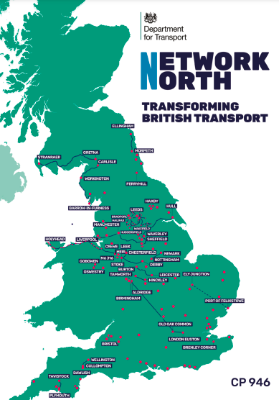
Barrow Hill Line (BHL) Update
Indicative milestones:
March 2024: Outline Business Case completion
June 2024: Decision to proceed to full business case
Autumn 2025: Completion of Full Business Case
December 2025: Decision to proceed to construction
Network North
Government’s new transport plan states that the re-opening of the Barrow Hill Line has been allocated funding to deliver. The DfT has advised that delivery is subject to development of a positive business case for investment.

Slide 4
Requirement for Town Deal Funding
Minimum Viable Product (MVP)
The Outline and Full Business Cases for BHL are anticipated to focus on the minimum infrastructure needed to re-open the BHL to passenger traffic to maximise a a positive assessment of value for money.
£934,000 Town Deal Funding can provide additionality to MVP investment to support a higher quality transport offer for getting to Barrow Hill station, and on-station facilities.
Network North provides a positive boost to retention of Town Deal funding to deliver the Barrow Hill Station project.

Slide 5
Town Deal Funding Options –
Five Board Recommendations
Notes Board decision in July 2023 to invest £122,000 in bus passenger information signs at bus stops, and leisure wayfinding.
Approval of a Phase 2 package of measures totalling £300,000.
Approval of a Phase 3 allocation of £215,000 to support delivery of an enhanced Demand Responsive Bus Service.
Notes that a further report will seek to allocate funding to community and greenspace.
Retains £231,000 funding towards on-station facilities until June 2024 and Department for Transport decision on Full Business Case preparation.
Criteria
Whether measures are deliverable within the Town Deal funding timeframe of completion by March 2026.
Whether measures provide transport benefits to Staveley and Barrow Hill independently of any future decision to deliver a Barrow Hill rail station.
That the investment is not abortive should a Barrow Hill station be delivered in future.
Anticipated business case outcomes.

Slide 6
Phase 1: Update
DCC Public Transport has identified:
Five locations for passenger information screens:
Duke Street (adjacent Devonshire Street). Services:74, 74a, 77, 77a, 78, 80, 80a, 81, 90
Erin Road, Ireland Industrial Estate (Adjacent Country Park). Services: 74, 81, 90
Poolsbrook, The Grove. Services: 74, 81, 90
Barrow Hill Post Office (NE). Service 90.
Barrow Hill Post Office (SW). Service 90.
Summary screen on High Street. Services 74, 74a, 77, 77a, 78, 80, 80a, 81, 90.
Bus shelters at:
Chesterfield Road, Staveley (adjacent Lime Avenue).
Duke Street, Staveley (as above).

Slide 7
Phase 2 Package
Business Case Schemes | Proposed Project | Cost
Pedestrian crossings on highway (M) Pedestrian routes to the station (M) | This project seeks to combine the two £100,000 allocations to improve pedestrian routes and crossings within Barrow Hill village. This would include (subject to detailed design): Pedestrian refuge crossing across junction of Station Road with Whittington Road. Pedestrian crossing improvement across Campbell Drive. Improved footways and further delivery of dropped crossings across the village. Provision of a humped Zebra crossing near the Post Office on Station Road. | £200,000
Covered and secure cycle parking (M) | This project seeks to provide a covered cycle parking shelter within the Barrow Hill Memorial Hall car park which would support those proposals in the short term, but then be available to provide cycle parking adjacent to the new station site. | £15,000
Shared bicycle scheme (C) | This project could expand the Wheels to Work programme to provide additional electric bicycles to the support the communities of Barrow Hill and Staveley for use of electric bikes for travel to employment or training. This scheme would not provide general cycle hire. | £36,000
Scheme development | The business case included funding for scheme development This is required to support design and delivery of the transport measures set out for approval in this report. | £49,000
Total Phase 2 Package |  | £300,000

Slide 8
Phase 3: Enhanced Demand Responsive Transport Service
Town Deal funding is currently 100% capital.
Allocation to provide an enhanced Demand Responsive Transport for 18 months to develop a viable commercial service is subject to Department for Levelling Up, Housing and Communities approval.
Project could be delivered alongside proposed North East Derbyshire Demand Responsive Transport scheme being delivered by the Derbyshire Bus Service Improvement Plan.
Alternatively, a capital project to deliver an expanded public transport infrastructure enhancement programme could be considered by the board at its next meeting.

Slide 9
Retention of £231,000 to provide higher quality station facilities
£231,000 balance to consider allocations to:
Enhanced lighting | (£60,000)
Electric vehicle charging | (£24,000)
Segregated access for pedestrians | (£80,000)
WIFI | (£9,000)
Bus information at the railway station | (£8,000)
Toilets (with baby change) | (£100,000)
Additional seating | (£3,000)
Parcel lockers | (£10,000)
Water fountain | (£4,000)
Work hub | (£25,000)
Vending machines | (£10,000)
Total cost estimates: | £333,000
NB Board members are being asked to consider holding the remaining Town Deal funds of £231,000 as a contribution to items set out above | £231,000

