Slide 1

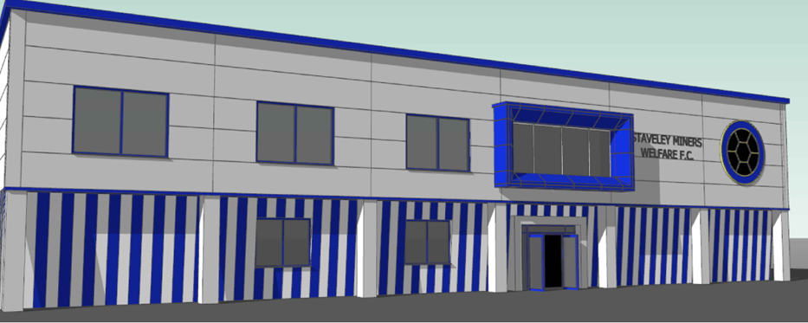
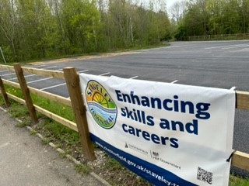
The Approved Project: Staveley Miners Welfare Football Club (Skills Academy)
Project Sponsor: SMW Football Club
Staveley Miners Welfare Football Club plans to create a new education space where young people will be able to gain BTECs or similar qualifications in sport. The funding will be used to create classroom space above the club house and improve the car park near to the Chantry Playing Fields.
Planning permission in place, match funding still required and two legal matters to resolve
Key Outputs
1 New community/ sports centre
400m2 of improved community / sports centre
1 New or improved training or education facilities
Up to 40 learners enrolled in new education and training courses each year
84 of new or improved car parking spaces – 83 spaces with 6 disabled bays delivered
Plus – Accelerator Fund - successfully delivered junior pitch drainage project

Slide 2
Latest Position
Open procurement in October. 5 tenders received, all well over budget, therefore, first floor building above Club House could not proceed
Options considered
Convert the existing building in the corner of the grounds to provide one lecture room suitable for Cohort One only
Convert the existing building in the corner of the grounds to provide lecture room 1 and seek a planning permission amendment to also install 4 (two storey) portacabins as classrooms on two areas of the site. 5 rooms in total
Stop the project and not deliver training to young people

Slide 3
Proposal (preferred Option)
To deliver the project in two stages:
Stage One
To commence the fit out and set up of one lecture room in existing building (this does not require planning permission)
Recruit 15-20 student by February 2024 for Sept 2024 intake
Stage Two
Develop proposals and submit to planning permission for the creation of additional lecture rooms (2-5) space using portacabins within existing site boundary.
To recruit students by February 2025 for Sept 2025 intake

Slide 4
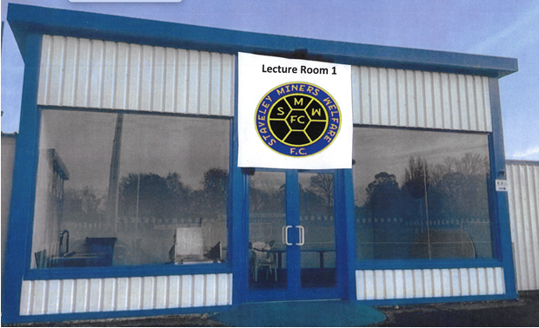
New Project Deliverables
Key Outputs
1 New community/ sports centre (increase to 5)
400m2 of improved community / sports centre (tba – est 230m2)
1 New or improved training or education facilities
Up to 40 learners enrolled in new education and training courses (still deliverable – (15 - 24/25, 15 – 25/26, 10 – beyond April 2026)

Slide 5
Town Deal Funding*
Total TF Allocation: £615,000
Spent £160,000 (car park) and £17,650 (5%)
Available funds £437,350
Lecture room one, legals and design costs: £60,000
Lecture rooms 2 – 5: £377,350
* Football Foundation support is also being sought - £70,000

Slide 6
Staveley Miners Welfare Football Club (Skills Academy)
Asks of the Town Deal Board
To agree a two stage approach to delivering the project
To approve (subject to business case, BCR and PAR) a sum of £60,000 for Stage One, to commence the set up of Lecture Room One
Town Deal Board to receive an update on student recruitment numbers for Sept 2024 intake by the March Board meeting
If student recruitment is successful, Town Deal Board to approve in principle, Phase Two funding to enable the construction of Lecture rooms 2-5 £377K subject to procurement process

