Slide 1

Staveley Town Deal Board
Staveley Wheels to Work Project
15 September 2023

Slide 2
Project Components
Wheels to Work £57,000
Electric Vehicle Charge Points £30,000
Real Time Public Transport Information signs £30,000

Slide 3
Wheels to Work
Update on progress of the SLA and timescales for future delivery
Town Deal funding
DCC was awarded £57,000 to develop a scheme to address transport barriers to employment and skills in the Staveley area.
Rural action Derbyshire’s Wheels to Work programme offers an opportunity to improve access to employment and training opportunities for Staveley residents by providing them with affordable and environmentally friendly transport options.
Developing the local workforce and supporting economic growth and social inclusion in the area.
Proposal for W2W, Staveley
Operation by Rural Action Derbyshire, following the Countywide ‘Wheels to Work’ programme model.
Offering affordable and environmentally friendly transport support
Purchase of Electric Vehicles: 5 e-mopeds and 10 e-bikes, which will be made available exclusively to residents of Staveley.
Improving access to employment and training opportunities
Referrals to the programme from a variety of sources
SLA progress
Service Level Agreement has been finalised, signed by RAD, with DCC for signing.
Single lump sum payment of £57,000 to be made to RAD by 30th September 2023
Output
Purchase and make available to Staveley learners or job seekers of 5 e-mopeds and 10 e-bikes
15 individuals accessing training or employment opportunities through the Project by accessing reliable transport
Timeline
Vehicles to be made available to users from 15th November 2023
Programme to run through to 31st March 2026
Notes:
The proposed solution within the Staveley Town Deal Contract proposal aims to address transport barriers to employment and skills in the Staveley area.
The solution seeks to improve access to employment and training opportunities for Staveley residents by providing them with affordable and environmentally friendly transport options, thereby promoting economic growth and social inclusion in the area.
The key components of the solution include:
Purchase of Electric Vehicles: Acquiring 5 e-mopeds and 10 e-bikes, which will be made available exclusively to residents of Staveley. These electric vehicles will serve as a means of transport for individuals who face difficulties accessing training or work opportunities due to factors like high transport costs or lack of suitable public transport options.
Transport Support for Candidates: The primary mode of providing transport support to candidates will be through electric cycles and scooters. By offering these vehicles, local candidates will have a convenient and affordable means of transport to access work or training opportunities. This approach aims to reduce reliance on personal cars for commuting.
Operation by Wheels to Work (W2W): The Staveley scheme will be operated by Wheels to Work (W2W) according to their standard operating model. W2W is an existing program known for its success in helping individuals overcome transport barriers to employment and skills on a case-by-case basis.
Referral Sources: Referrals to the program may come from various sources, including job centers, employers, recruitment agencies, and other relevant entities. This wide range of referral sources ensures that individuals in need of transport support are identified and connected with the program.

Slide 4
Electric Vehicle Charge points
Update on progress and timescales for future delivery
Town Deal funding
DCC was awarded £30,000 to support the delivery of electric vehicle charge points
The Healthy Living Centre was identified as the most suitable location
In parallel, DCC identified the same location, and 7 others across Chesterfield, to be delivered through the Countywide LEVI ‘Destination Charging’ programme. Developing ‘destination’ short – medium stay charging network providing fast – ultra rapid charging options
Proposal for The Healthy Living Centre, Staveley
As alternative funding sources for the LEVI programme are available, the £30,000 allocated from the Town Deal would be better utilised elsewhere.
Delivery of the charge points will remain a Town Deal objective with all associated marketing and promotion recognising this.
The slightly revised proposal will still result in the implementation of a minimum of 4 x electric vehicle charging points, offering up to 50kWh Fast – Rapid charging.
Timeline
Tender exercise to be carried out in Autumn 2023
Installation likely to commence Spring 2024, subject to statutory consultations
Residential/ On Street Charging
Additionally to the Destination Charging programme, Derbyshire County Council continue to progress the development of on-street ‘slow’ charging network
The network will reach all areas of the County, including Staveley
Utilising existing power feeds from lamp columns to provide overnight charging options for residents and visitors
Primarily focusing on residential areas without off street parking.
Timeline
Anticipate installation to commence through winter 2023

Slide 5
Real Time Public Transport Information (RTPI) Signs
Town Deal funding
DCC was awarded £30,000 to support the installation of Real Time Public Transport Information Signs
Two signs were proposed to be provided in hub buildings (location unknown).
However, RTPI signs have already been provided at the bus station and the Healthy Living Centre bus stop, which is considered by the Town Deal team to fulfil need.
Proposal for Staveley
Public transport team advise there is potential to provide an additional four RTPI signs along the Service 90 route (see next slide) from the £30,000 budget.
These would expand access to RTPI across the Staveley Town Deal area.
Timeline
Current procurement Framework Contract ends in November 2023 and therefore funding would need to be passed to DCC by early October 2023 to deliver these.
Otherwise access to the new Framework Contract would be approximately March 2024.
Next Steps
DCC to identify locations in and around Town Square and on key bus stops
Locations would be subject to electrical connection being available.

Slide 6
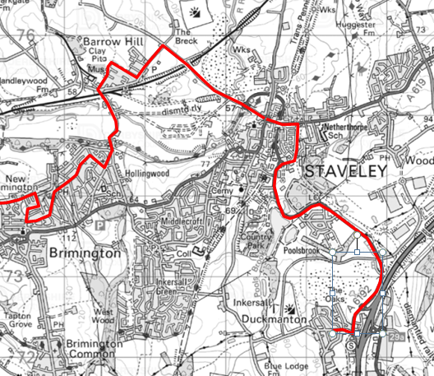
Bus Route 90

Slide 7
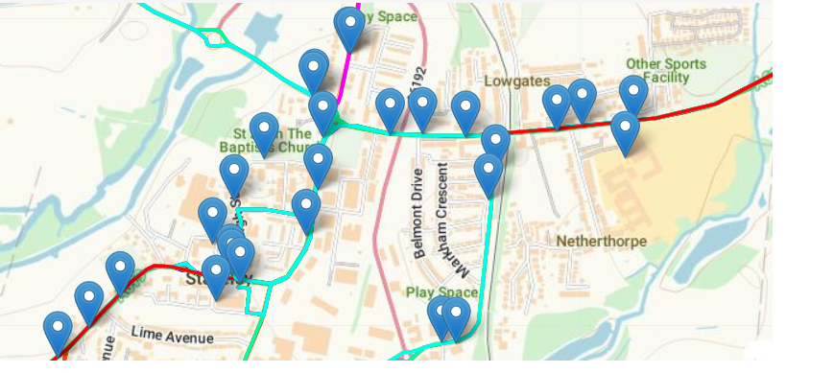
Staveley Bus Stops

Slide 8
Recommendations & Decisions
It is recommended that the Staveley Town Deal Board;
Wheels to Work
  Note the key components and expected outcome. Further update will be provided as the scheme progresses.
Electric Vehicle charge points
  Note progress and delivery timescales for electric charge points in Staveley.
  Advise approach to use of £30,000 electric vehicle charge point funding.
Real Time Public Transport Information Signs
  Collaborate with DCC officers to identify suitable locations for additional RTPI signs
  Expediate transfer of funding to ensure delivery this financial year

