Slide 1
Staveley Town Deal Board
16th June 2023
DRIIVe Project Update

Slide 2
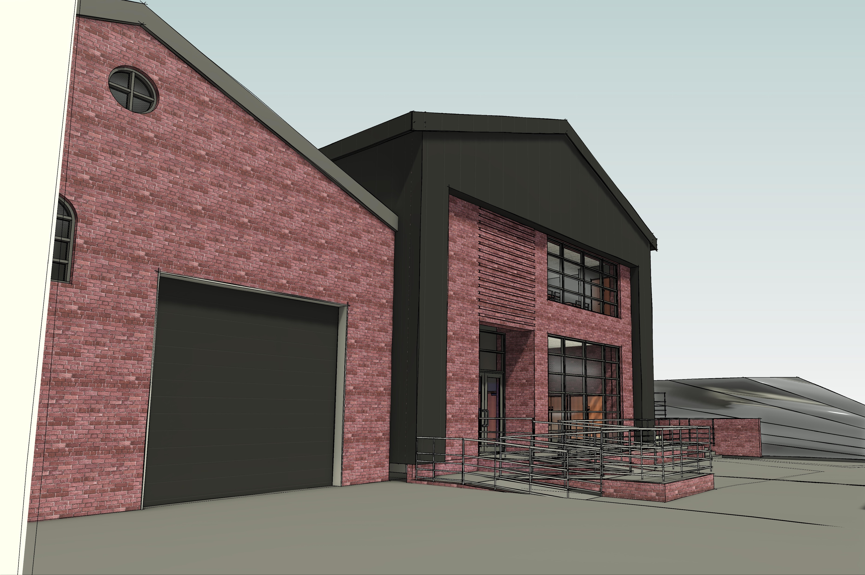
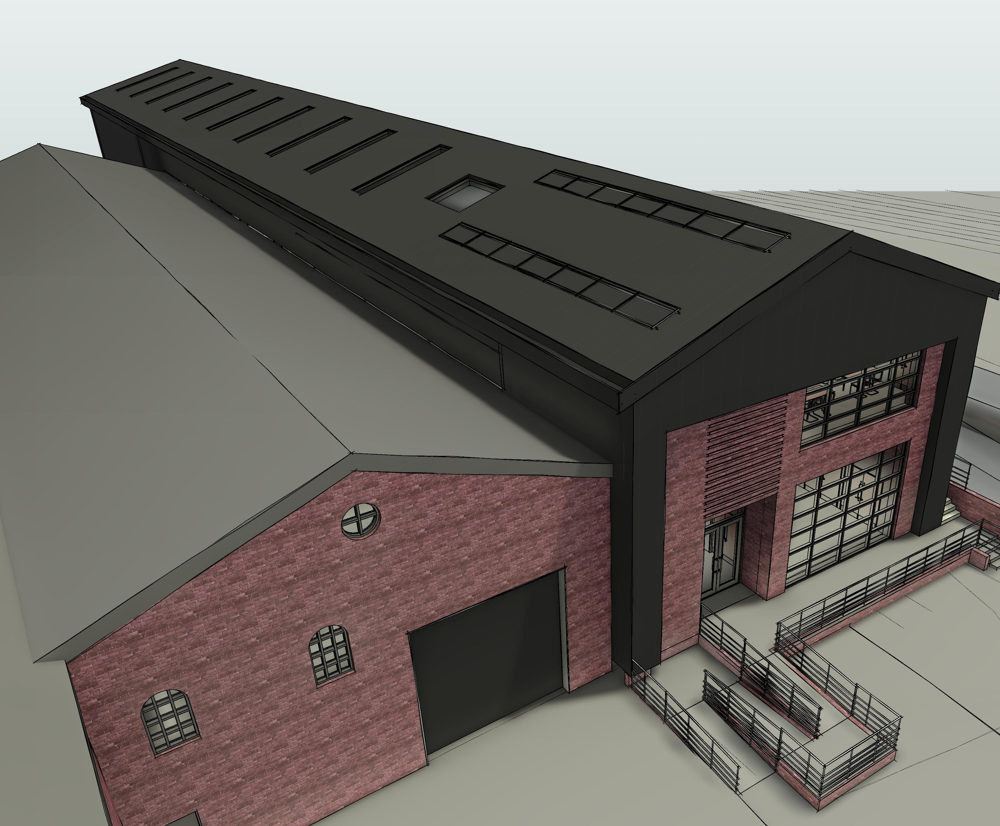
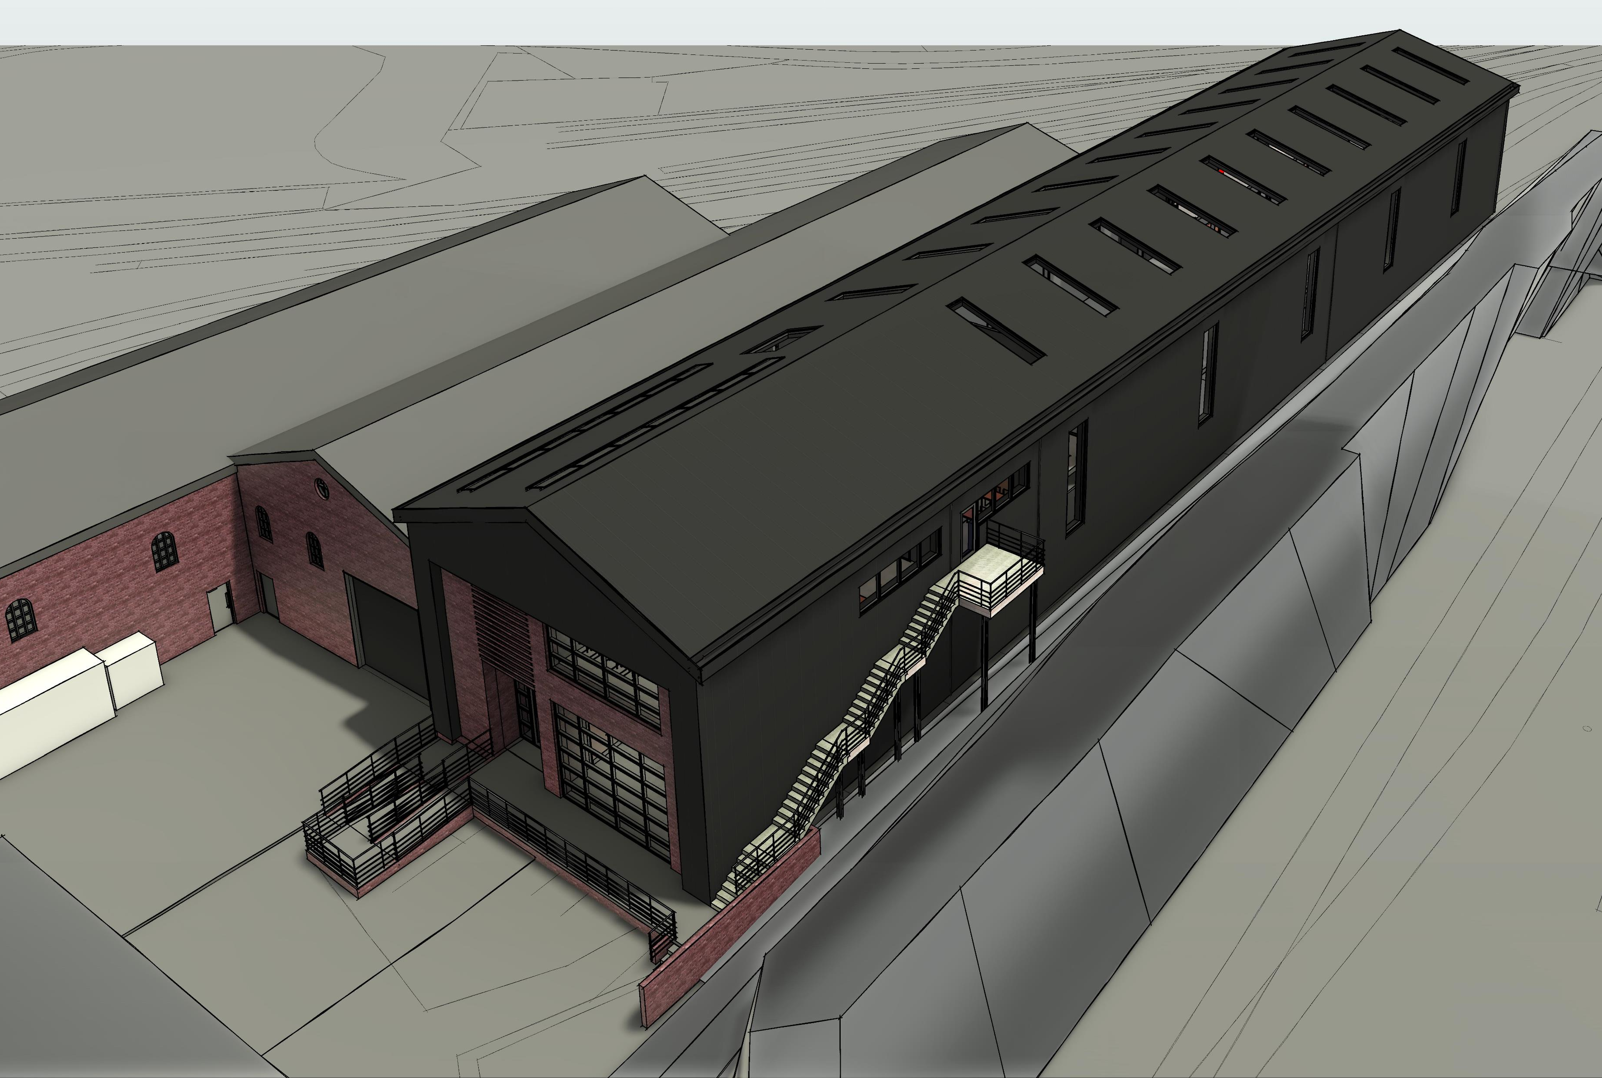

Slide 3
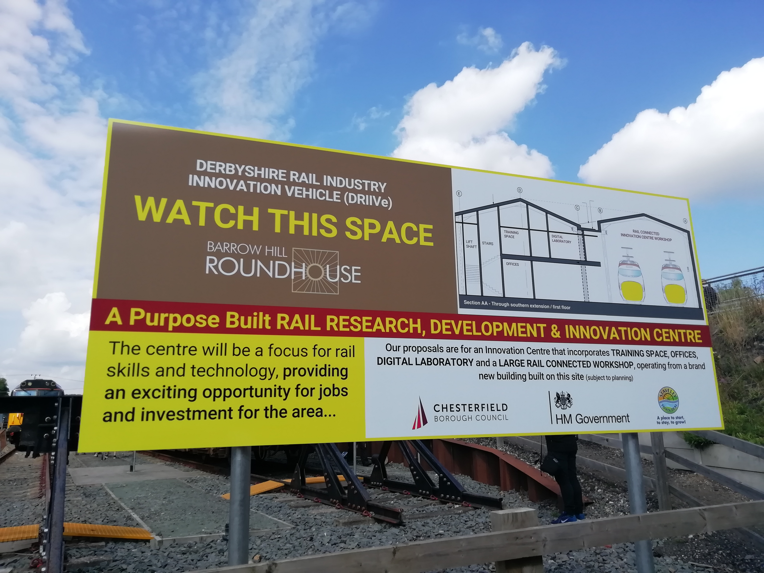
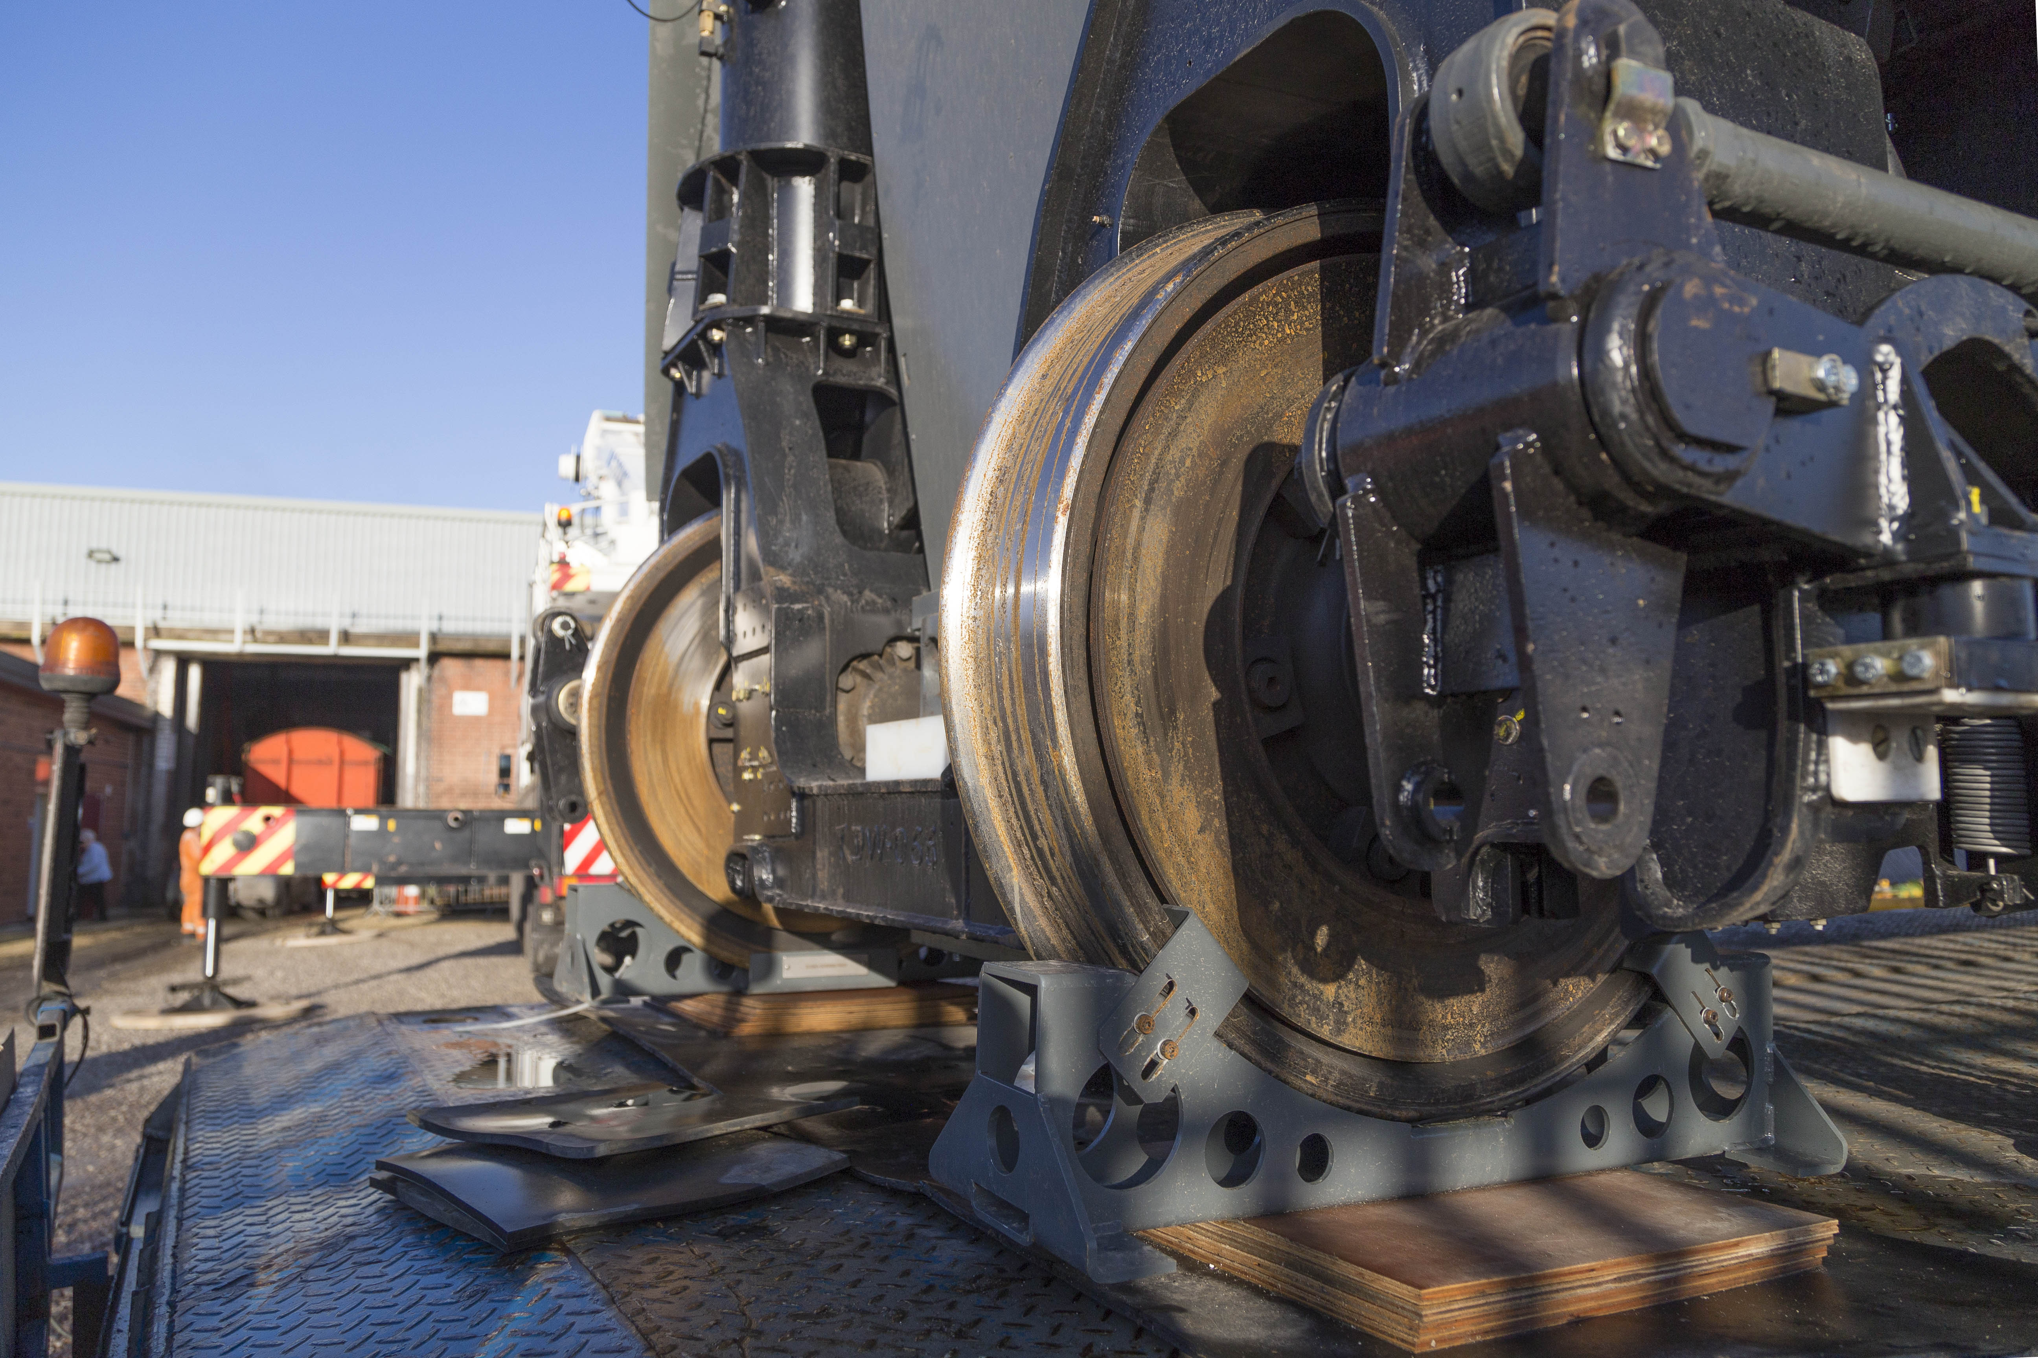
Current Position: Design Milestones
Appointed Engineer Led Design Team
Commissioned SI/surveys and reviewed the results
Architects Design Strategy presented to Project Board
Civils and Structural Design Strategy presented to project board
Ground Investigation
Oct 2022
Nov 2022
Jan 2023
Jan 2023
Jan 2023
Feb 2023
Mar 2023
Mar 2023
Apr 2023
Coal Authority Permit agreed
Review Stage 2 Maber designs
Appointed a BREEAM consultant
Architect Design evolution, and M&E Design Strategy presented to Project Board

Slide 4
Next Steps
Final RIBA Stage 3 designs presented to Project Board
Agree Procurement route for main contractor
Formal Pre-application meeting
Planning submission
Completion of RIBA Stage 6
21 June 2023
28 June 2023
26 July 2023
1 Sep. 2023
1 Sep. 2025
21 June 2023
5 July 2023
1 Aug. 2023
25 June 2024
RIBA Stage 3 Design Freeze
RIBA Stage 3 report signed off
RIBA Stage 4 to commence
RIBA Stage 5 Construction

